Slide 1
PMCA601 Full Stack Web technology
Module – 7 Full Stack Integration and Deployment
NoSQL Database – MongoDB Basics – Documents, Collections, Database, Query Language, Installation, The Mongo Shell – MongoDB CRUD Operations – MongoDB Node.js Driver – Schema Initialization – Reading from MongoDB – Writing to MongoDB

Slide 2
MongoDB – Introduction
MongoDB is an open-source, cross-platform, and distributed document-based database designed for ease of application development and scaling. MongoDB is not a Relational Database Management System (RDBMS). It's called a "NoSQL" database. It is developed by MongoDB Inc.
It stores data in the collections as JSON based documents and does not enforce schemas. It does not have tables, rows, and columns as other SQL (RDBMS) databases.
MongoDB vs RDBMS Terminologies
MongoDB | RDBMS
Database | Database
Collection | Table
Document | Row (Record)
Field | Column

Slide 3
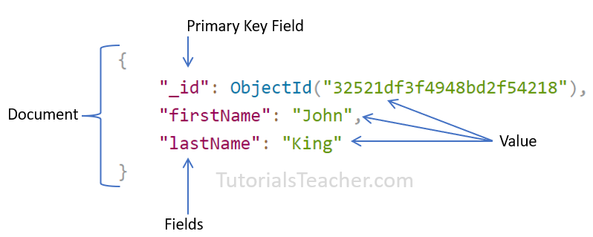
MongoDB – Introduction
JSON based document structure:

Slide 4
MongoDB – Advantages
MongoDB stores data as JSON based document that does not enforce the schema. It allows us to store hierarchical data in a document. This makes it easy to store and retrieve data in an efficient manner.
It is easy to scale up or down as per the requirement since it is a document based database. MongoDB also allows us to split data across multiple servers.
MongoDB provides rich features like indexing, aggregation, file store, etc.
MongoDB performs fast with huge data.
MongoDB provides drivers to store and fetch data from different applications developed in different technologies such as C#, Java, Python, Node.js, etc.
MongoDB provides tools to manage MongoDB databases.

Slide 5
MongoDB – Introduction
For, installation refer the following site:
https://www.tutorialsteacher.com/mongodb/install-mongodb
Mongosh – Shell to handle MongoDB queries. It is available in the installed folder ‘bin’ (in general, c:\program files\MongoDB\Server\version(4.4)\bin.
MongoDB Compass – It is a GUI oriented platform for querying, aggregating and analyzing the MongoDB data.

Slide 6
MongoDB – Data Types
MongoDB supports many datatypes. Some of them are −
String − This is the most commonly used datatype to store the data. String in MongoDB must be UTF-8 valid.
Integer − This type is used to store a numerical value. Integer can be 32 bit or 64 bit depending upon your server.
Boolean − This type is used to store a boolean (true/ false) value.
Double − This type is used to store floating point values.
Min/ Max keys − This type is used to compare a value against the lowest and highest BSON elements.

Slide 7
MongoDB – Data Types
Arrays − This type is used to store arrays or list or multiple values into one key.
Timestamp − timestamp. This can be handy for recording when a document has been modified or added.
Object − This datatype is used for embedded documents.
Null − This type is used to store a Null value.
Date − This datatype is used to store the current date or time in UNIX time format. You can specify your own date time by creating object of Date and passing day, month, year into it.
Object ID − This datatype is used to store the document’s ID.

Slide 8
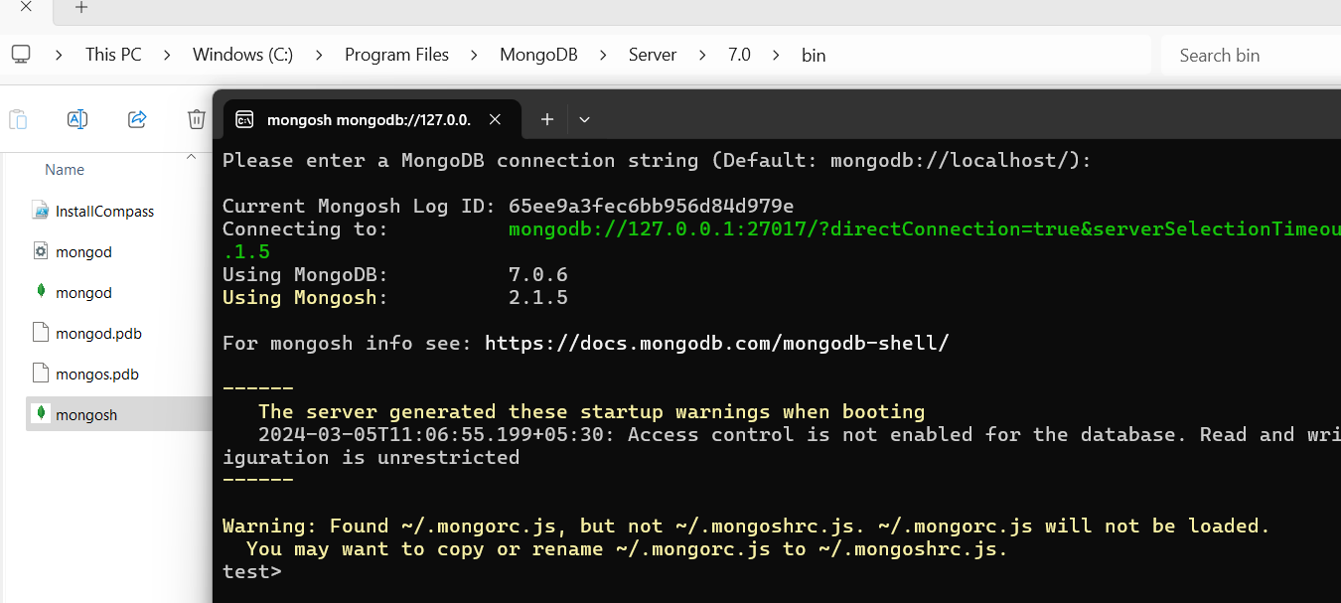
MongoDB – Open MongoDB Console
Click the ‘mongosh.exe’ to open the Mongo shell from the installed folder as highlighted below:

Slide 9
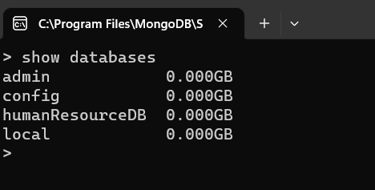
MongoDB – Commands
>show databases – List all available databases in MongoDB

Slide 10
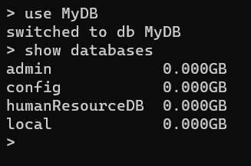
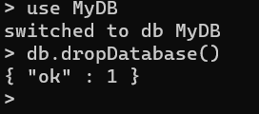
MongoDB – Commands
>use database – is used to create database. The command will create a new database if it doesn't exist, otherwise it will return the existing database.
MyDB is created and it doesn’t visible until create a collection
>db.dropDatabase() – command is used to drop a existing database.

Slide 11
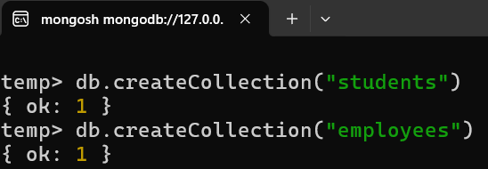
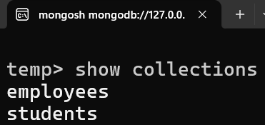
MongoDB – Commands
>db.createCollection(name, options) – is used to create collection. It is ideal if you keep the collection name in plural.
>show collections – lists the created collection(s)

Slide 12
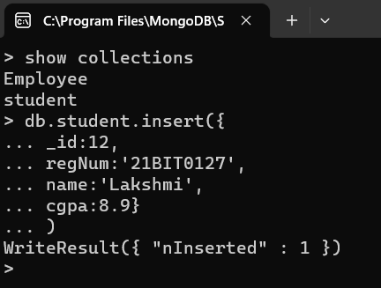
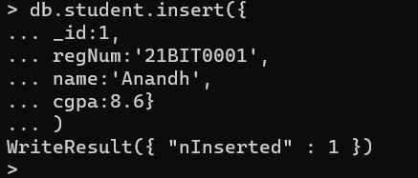
MongoDB – Insert Document
>db.COLLECTION_NAME.insert({field1: value[, filed2:value,…]}) – used to insert a document into the collection.
[‘insert’ is deprecated in version 3.2 and later removed in version 4.0
Array of documents can be inserted by using this insert. If only one document should be inserted, then can use this command
>db.COLLECTION_NAME.insertOne({field1: value[, filed2:value,…]})

Slide 13
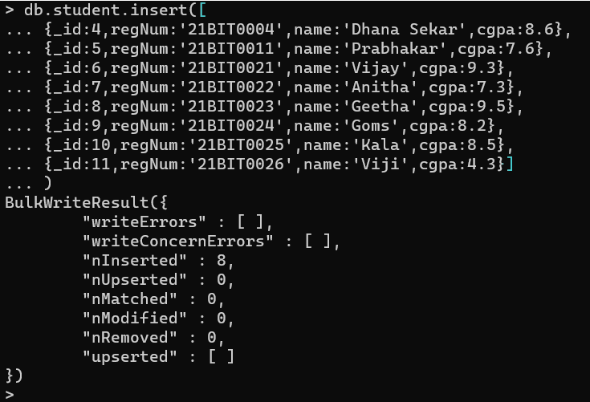
MongoDB – Insert Array of Document

Slide 14
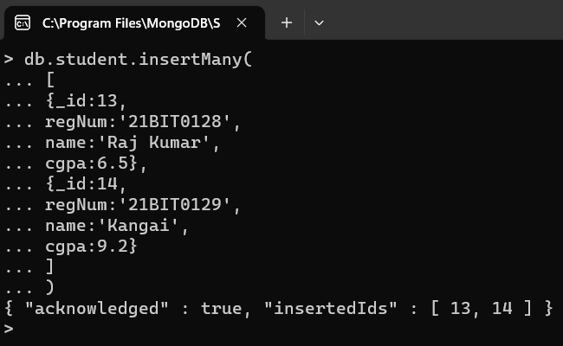
MongoDB – Insert Many
The db.<collection>.insertMany() inserts multiple documents into a collection. It cannot insert a single document.
db.collection.insertMany(
[ {document1},
{document2},
....],
)

Slide 15

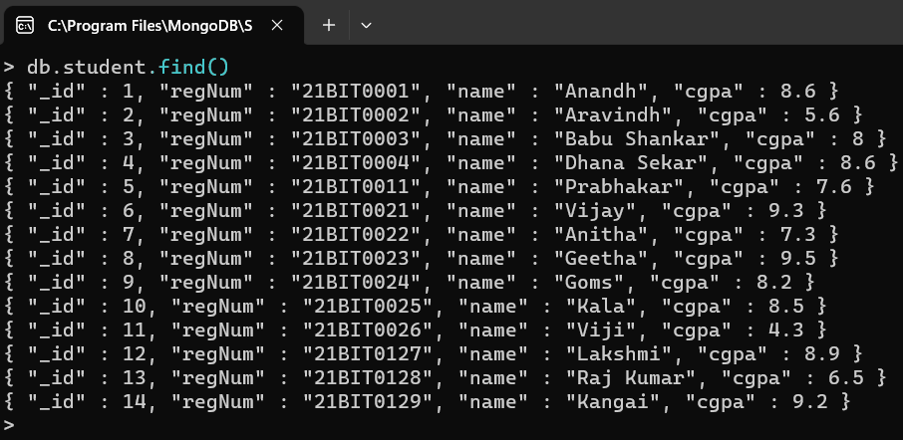
MongoDB – Find Document
MongoDB provides two methods for finding documents from a collection:
findOne() - returns a first document that matched with the specified criteria.
Syntax:
db.COLLECTIONAME.find()
find() - returns a cursor to the selected documents that matched with the specified criteria
Syntax:
db.COLLECTIONAME.findOne()

Slide 16
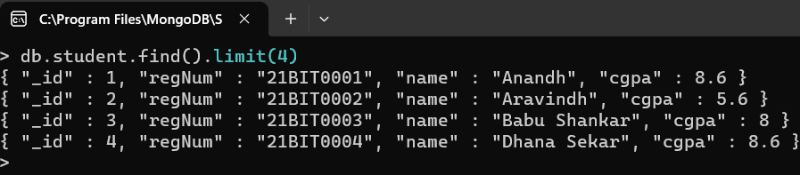
MongoDB – Find Document
find().limit() - returns first specified number of documents.
Syntax:
db.COLLECTIONAME.find().limit(num)

Slide 17
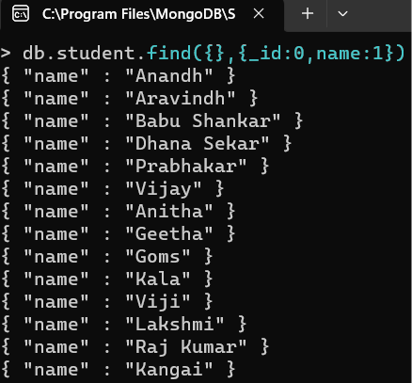
MongoDB – Find
To list few fields of a collection the find query can be applied with projection like this:
db.collectionName.find({},{fieldname:0/1[,fieldname:0/1,….})
Here, 0 means the field should not list, 1 means it has to list.
Example:
db.student.find({},{_id:0,name:1})
The first {} of find() indicates the filter to be applied and the second {} indicates the projection of fields. Both are optional. If you want to use the projection and filter is not required then can use the empty {}.

Slide 18
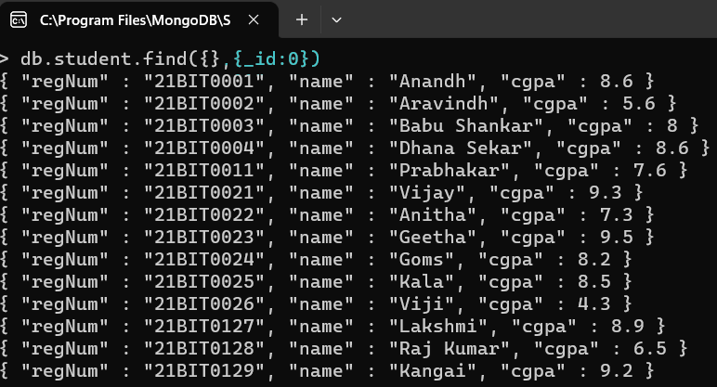
MongoDB – Find With Projection
All fields are listing while only one has not to list
db.collection.find( {}, {field:0} )
Example:
db.student.find( {}, {_id:0} )
Lists all fields except ‘_id’

Slide 19
MongoDB – Query Selectors
Selector | Description
$eq | Matches values that are equal to a specified value.
$gt | Matches values that are greater than a specified value.
$gte | Matches values that are greater than or equal to a specified value.
$in | Matches any of the values specified in an array.
$lt | Matches values that are less than a specified value.
$lte | Matches values that are less than or equal to a specified value.
$ne | Matches all values that are not equal to a specified value.
$and | Joins query clauses with a logical AND returns all documents that match the conditions of both clauses.
$not | Inverts the effect of a query expression and returns documents that do not match the query expression.
$nor | Joins query clauses with a logical NOR returns all documents that fail to match both clauses.
$or | Joins query clauses with a logical OR returns all documents that match the conditions of either clause.

Slide 20
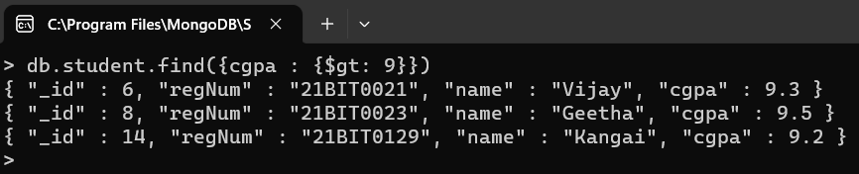
MongoDB – Find With Selectors
List the documents which are met with the given condition(s):
db.collectionName.find( { field: {selector : value [, selector : value, etc ]} } )
List the documents of student collection with the cgpa more than ‘9’
db.student.find( {cgpa: {$gt : 9} } )

Slide 21
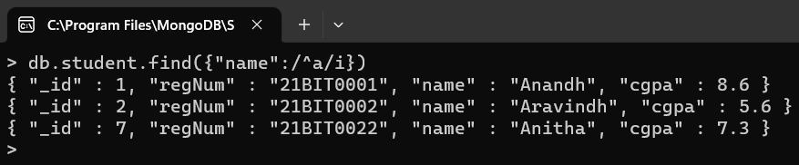
MongoDB – Find with Selectors
To list the documents which has name starting with the letter ‘a’
db.student.find({"name":/^a/i})

Slide 22
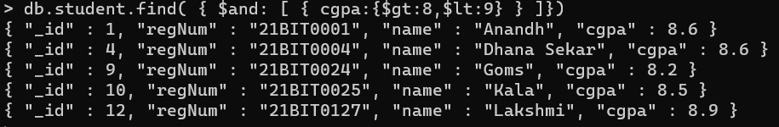
MongoDB – Find With Selectors
List the documents of student collection with the cgpa more than ‘9’ and less than ‘8’
db.student.find( {cgpa: {$gt:8, $lt:9} } )

Slide 23
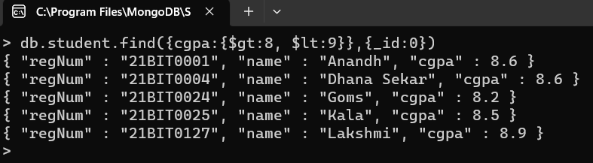
MongoDB – Find With Selectors
List the documents of student collection with the cgpa more than ‘9’ and less than ‘8’ and without _id
db.student.find( {cgpa: {$gt:8, $lt:9} },{_id:0} )

Slide 24
MongoDB – Find With Selectors
List the documents of student collection with the cgpa between ‘9’ and ‘8’ and the name starts with the letter ‘a’
db.student.find( {$and: [{cgpa:{$gt:8,$lt:9}},{"name":/^a/i}]})

Slide 25
MongoDB – Find With Selectors
List the documents of student collection with the cgpa between ‘9’ and ‘8’ without ‘_id’ and the name starts with the letter ‘a’
db.student.find( {$and: [{cgpa:{$gt:8,$lt:9}},{"name":/^a/i}]},{_id:0})

Slide 26
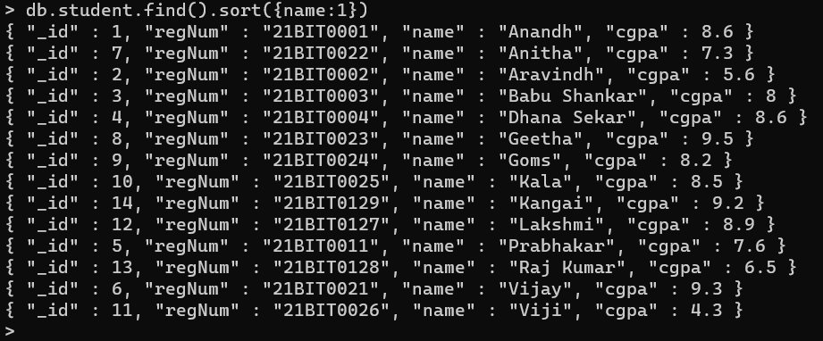
MongoDB – Sort in Ascending Order
List the documents in sorted order based on the field ‘name’:
db.student.find().sort({name:1}) – ascending order

Slide 27
MongoDB – Sort in Descending Order
List the documents in sorted order based on the field ‘name’:
db.student.find().sort({name:-1}) – descending order

Slide 28
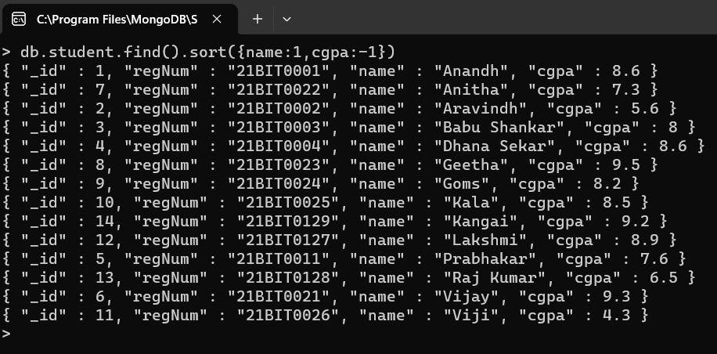
MongoDB – Sort on Multiple Fields
Sort on multiple fields
db.student.find().sort({name:1,cgpa:-1})

Slide 29
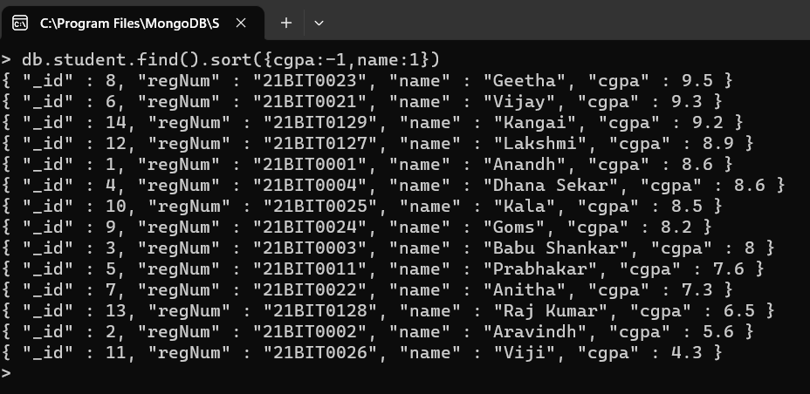
MongoDB – Sort on Multiple Fields
Sort on multiple fields
db.student.find().sort({cgpa:-1,name:1})

Slide 30
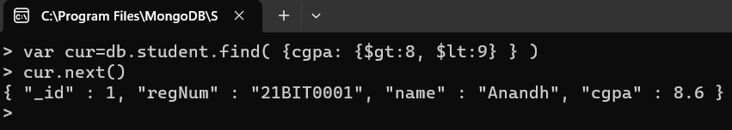
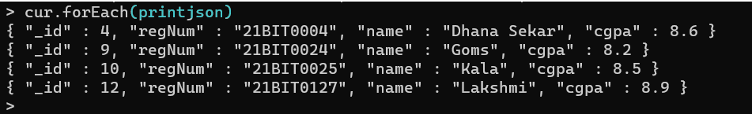
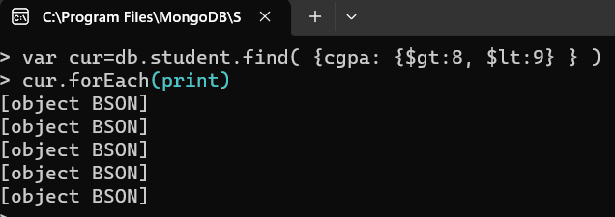
MongoDB – Cursor
The find() method returns a cursor object which can be used to iterate the result. next() is a method which returns the current document. forEach() iterates all documents and the printjson prints the document in JSON format.

Slide 31
MongoDB – Update Documents
MongoDB provides the following methods to update existing documents in a collection:
1. db.collection.updateOne() - updates a single document in a collection that matches with the specified filter criteria. It updates the first matching document even if multiple documents match with the criteria. Modifies a single document in a collection. Syntax:
db.collection.updateOne(filter, document)
Parameters:
filter: The selection criteria for the update, same as find() method.
document: A document or pipeline that contains modifications to apply.
2. db.collection.updateMany() - Modifies one or more documents in a collection.

Slide 32
MongoDB – Update Operators
Name | Description
$set | Sets the value of a field in a document.
$inc | Increments the value of the field by the specified amount.
$mul | Multiplies the value of the field by the specified amount.
$min | Only updates the value of the field to a specified value if the specified value is less than the current value of the field
$max | Only updates the value of the field to a specified value if the specified value is greater than the current value of the field.

Slide 33
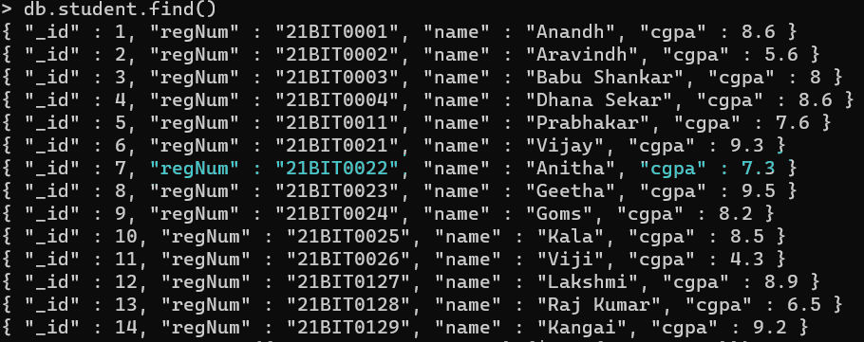
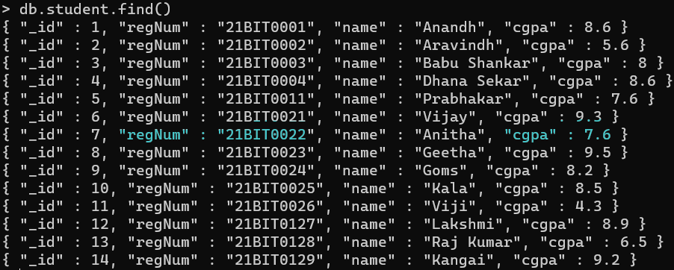
MongoDB – Update Operator Set
Update Command
Before Update
After Update

Slide 34
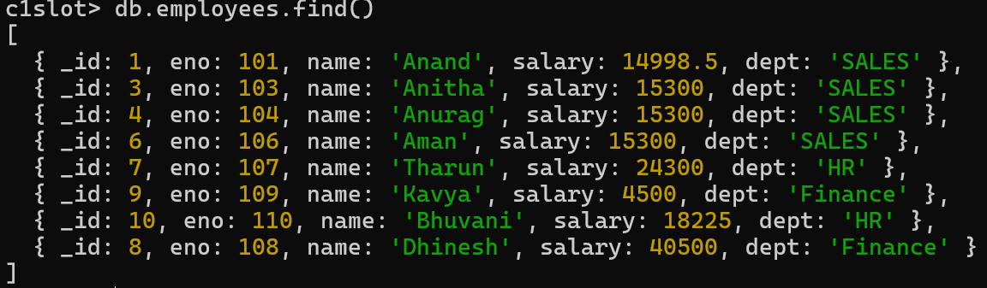
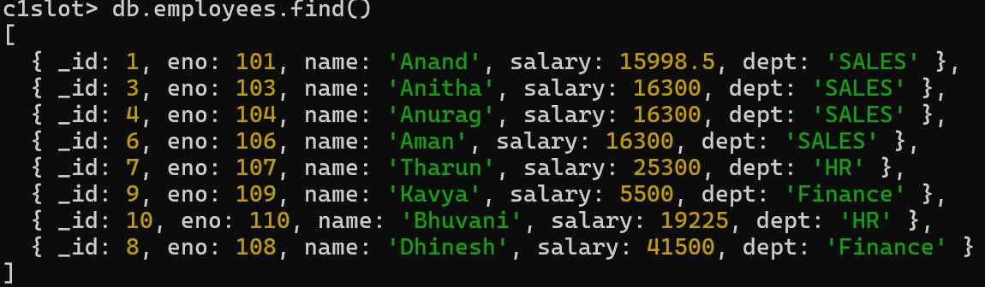
MongoDB – Update Operator inc

Slide 35
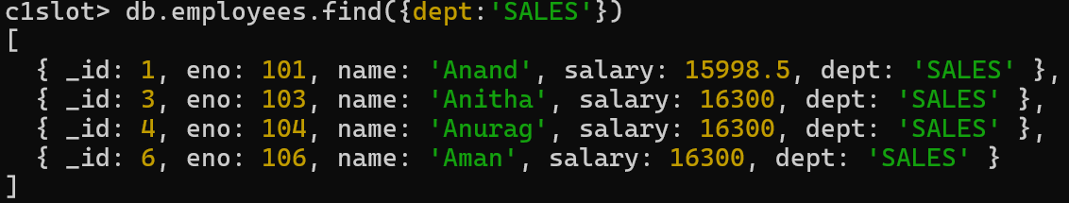
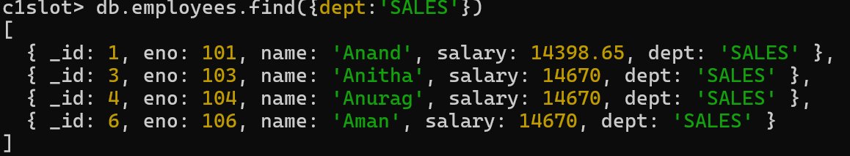
MongoDB – Update Operator mul

Slide 36
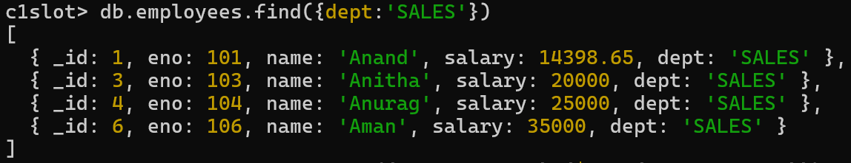
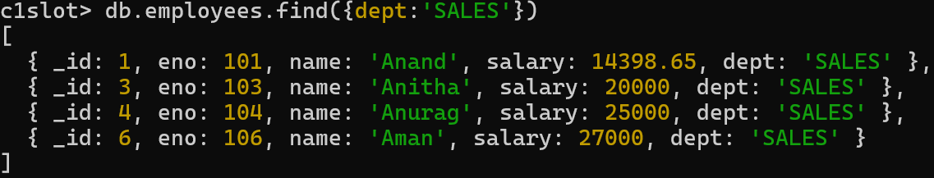
MongoDB – Update Operator min

Slide 37
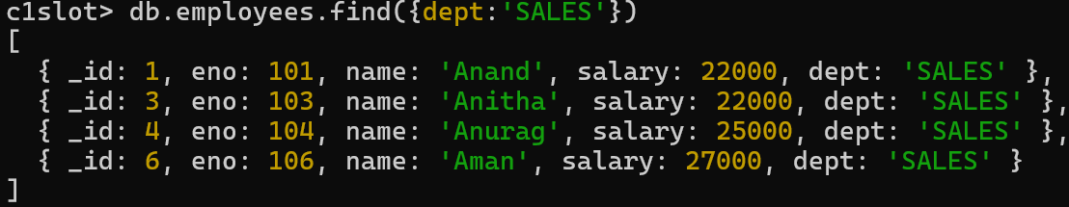
MongoDB – Update Operator max

Slide 38
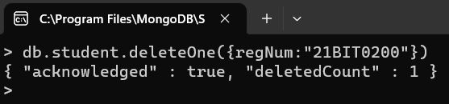
MongoDB – Delete Commands
MongoDB provides the following methods to delete one or more documents in a collection.
1. db.collection.deleteOne() - Deletes the first documents that match with the specified filter criteria in a collection.
2. db.collection.deleteMany() - Deletes all the documents that match with the specified filter criteria in a collection.
Syntax:
db.collection.deleteOne(filter)
Parameters: db.users.deleteOne({ name: "John" })
filter: The selection criteria for the update, same as find() method.
Sample Query: db.student.deleteOne({regnum:”21BIT0200”})

Slide 39
MongoDB – References
https://www.w3schools.com/mongodb/
https://www.tutorialspoint.com/mongodb/index.htm
https://www.tutorialsteacher.com/mongodb

